Slide 1
SIMPLE ATM INTERFACE

Slide 2
ABSTRACT
The Simple ATM Interface project is a comprehensive simulation of an Automated Teller Machine, designed to introduce students and developers to the architectural and functional aspects of real-world banking systems. The application combines a visually intuitive front end built with HTML, CSS, and JavaScript and a robust backend powered by Java, with persistent account management and transaction data handled through MySQL. By implementing critical banking operations—such as account login, balance inquiry, deposit, withdrawal, and transaction history—the system bridges the gap between theory and hands-on learning. It integrates database connectivity, form validation, and error handling, demonstrating the core principles of full-stack application development and secure transaction processing. The Simple ATM Interface highlights how data flows across different technology layers, providing learners with foundational experience in designing and securing modern financial applications

Slide 3
EXISTING SYSTEM
In the current landscape, ATMs act as essential platforms enabling users to perform self-service banking operations. However, these systems are largely inaccessible for educational exploration since banks restrict access for reasons of security and privacy. Most students and novice developers only encounter ATM functionalities through theoretical coursework and documentation. Direct exposure to the operational and architectural complexity of authentic ATMs is minimal because proprietary banking software and hardware are not shared outside institutional boundaries. This lack of transparency makes it extremely difficult to visualize and experiment with critical processes such as multi-tier authentication, transaction validation, or database synchronization, leaving a significant gap in practical understanding

Slide 4
PROPOSED SYSTEM
The Simple ATM Interface addresses these educational challenges by providing an open-source, web-based simulation of ATM operations. This proposed system offers a full-stack software environment where users can securely log in, check balances, deposit or withdraw funds, and review their transaction history. The modular frontend is user-friendly, with clear navigation and immediate feedback for each operation. A Java-based backend ensures secure execution of logic and connects to a MySQL database for reliable data storage. Each transaction updates the database in real time, ensuring consistency across all system layers. By simulating real-life ATM flows, the system gives learners the opportunity to experiment in a risk-free setting, deepen their understanding of database-driven web applications, and appreciate the importance of security practices in financial software

Slide 5
ADVANTAGES
The system delivers a hands-on, realistic platform for learning the intricacies of ATM software operations, integrating both client and server technologies.
Key software engineering principles—such as modular design, real-time feedback, and secure authentication—are demonstrated and reinforced in practical scenarios.
The architecture is scalable and upgradeable, making it easy to add new transaction types or advanced features, such as OTP authentication or detailed reporting.
The use of open-source tools and standard programming languages facilitates broad accessibility and encourages adaptation for different learning objectives or research projects.

Slide 6
DISADVANTAGES
The project does not interact with real banking networks or process actual cash transactions, which means some essential security and compliance challenges found in commercial ATMs are only theoretically addressed.
Security measures are limited to educational best practices and do not represent the highly advanced protocols used in real financial institutions.
The scope is intentionally simplified; features like multi-account management, card validation, and multi-factor authentication are not included but are present in professional ATM systems.

Slide 7
MODULES
The project is divided into clearly defined modules, each representing a major function of ATM operations:
User login/authentication
Dashboard with navigation menu
Balance enquiry
Deposit function
Withdrawal function
Transaction history record
Each module performs input validation, error checking, and direct interfacing with backend logic and database storage for full-cycle transaction management

Slide 8
MODULE DESCRIPTION
Login Module: Authenticates users via username and password, restricts system access to authorized users, and implements retry logic for failed attempts.
Deposit Module: Accepts numeric input, validates amounts, updates the account balance, and records the transaction with a timestamp in the database.
Withdrawal Module: Verifies current balance, prevents overdrafts, and updates balance and transaction history after successful checks.
Balance Inquiry: Instantly fetches and displays current user balance from the database.

Slide 9
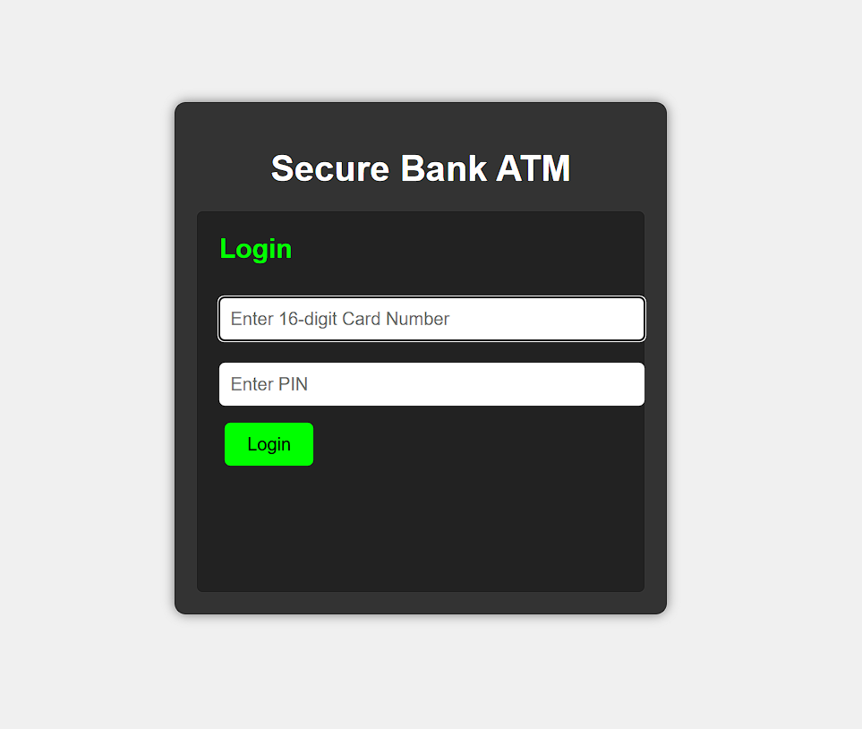
SAMPLE OUTPUT

Slide 10
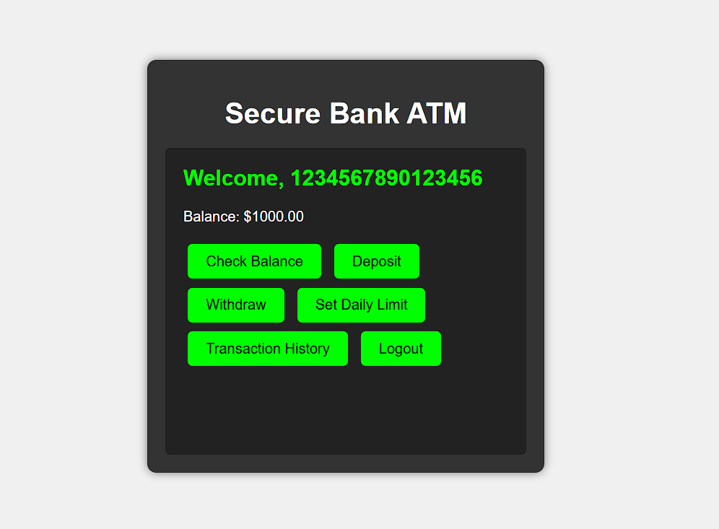
ATM OPERATIONS

Slide 11
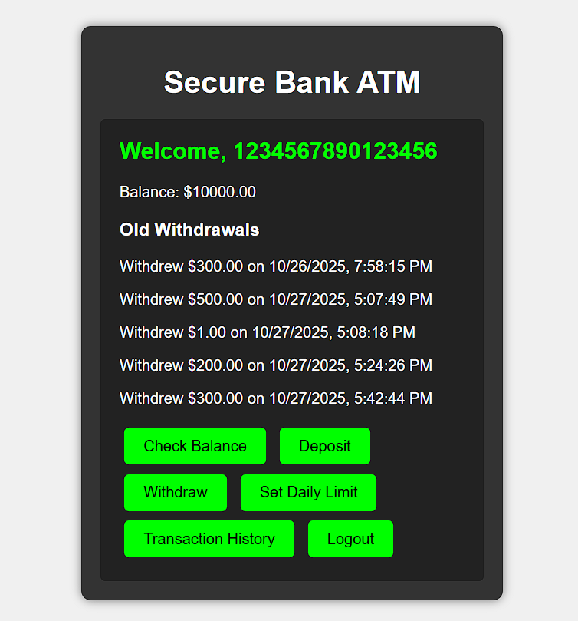
TRANSACTION HISTORY

Slide 12
CONCLUSION
The Simple ATM Interface stands as a practical educational and development platform, simulating authentic banking operations through a well-organized, multi-tier architecture. Its design encourages understanding of how web applications, backend logic, and relational databases interact in secure financial workflows. Learners gain experience with modular software engineering, multi-layered validation, and the fundamentals of robust, scalable system development. Ultimately, the project bridges classroom theory and real-world software practice, offering an invaluable springboard for further study in advanced topics such as security, networking, and enterprise financial system

Slide 13
THANK YOU

